Slide 1
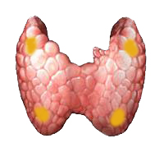
DISORDERS OF THE PARATHYROID GLANDS

Slide 2
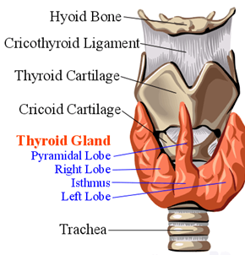
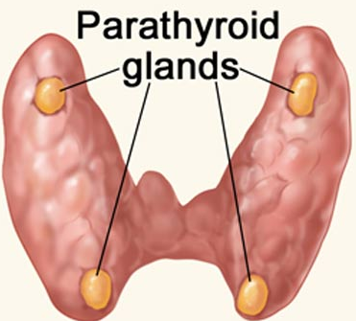
Thyroid and parathyroid gland

Slide 3
Disorders of the Parathyroid Glands
Maintenance of calcium, phosphate and magnesium homeostasis is under the influence of two polypeptide hormones; parathyroid hormone(PTH), and calcitonin (CT), as well as a sterol hormone, 1,25 dihydroxy cholecalciferol (1,25 (OH)₂D₃.

Slide 4
Disorders of the Parathyroid Glands
These hormones regulate the flow of minerals in and out of the extracellular fluid compartments through their actions on intestine, kidneys, and bones.

Slide 5
Disorders of the Parathyroid Glands
The PTH acts directly on the bones and kidneys and indirectly on the intestine through its effect on the synthesis of 1,25 (OH)₂D₃.
Its production is regulated by the concentration of serum ionized calcium. Lowering of the serum calcium levels will induce an increased rate of parathyroid hormone secretion

Slide 6
Disorders of the Parathyroid Glands
Calcitonin is released by the “C” cells (parafollicular cells in the thyroid gland) in response to small increases in plasma ionic calcium.
It acts on the kidney and bones to restore the level of calcium to just below a normal set point which in turn inhibits secretion of the hormone.

Slide 7
Disorders of the Parathyroid Glands
Calcitonin is therefore the physiological antagonist of PTH. The two hormones act in concert to maintain normal concentration of calcium ion in the extracellular fluid.

Slide 8
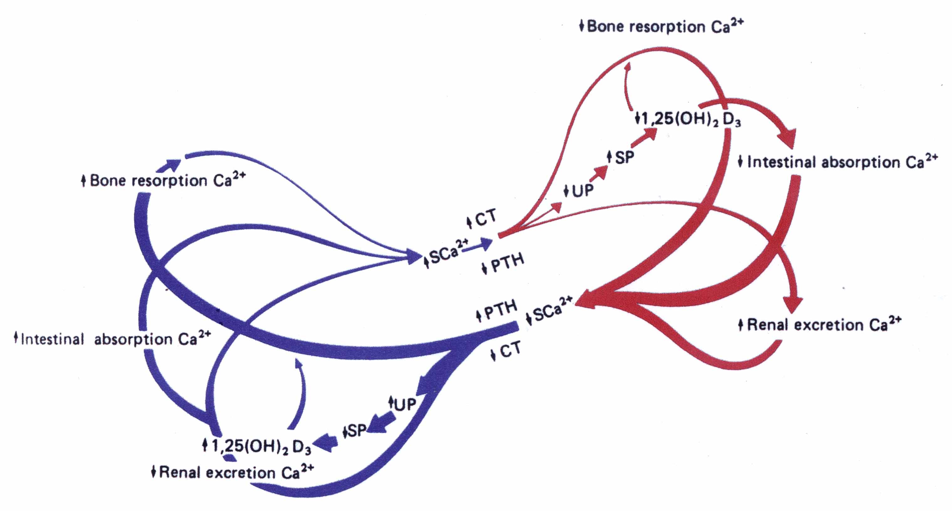

Slide 9
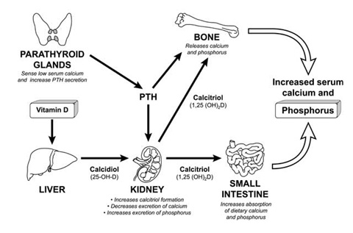
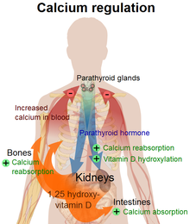

Slide 10
Disorders of the Parathyroid Function
Hyperparathyroidism
Primary hyperparathyroidismis due to excessive production of PTH by one or more of hyperfunctioning parathyroid glands. This leads to hyprcalcemia which fails to inhibit the gland activity in the normal manner.

Slide 11
Disorders of the Parathyroid Function
Hyperparathyroidism
The cause of primary hyperparathyroidism is unknown. A genetic factor may be involved. The clonal origin of most parathyroid adenomas suggests a defect at the level of the gene controlling the regulation and/or expression of parathyroid hormone.

Slide 12
Disorders of the Parathyroid Function
Hyperparathyroidism
The incidence of the disease increases dramatically after the age of 50 and it is 2-4 folds more common in women.
A single adenoma occurs in about 80% of patients with primary hyperparathyroidism.
Four glands hyprplasia account for 15-20% of cases.
A parathyroid carcinoma could be the etiology in a rare incidence of less then 1%.

Slide 13
Disorders of the Parathyroid Function
Clinical Features:
The two major sites of potential complications are the bones and the kidneys.
The kidneys may have renal stones (nephrolithiasis) or diffuse deposition of calcium-phosphate complexes in the parachyma (nephrocalcinosis).
Now a days such complications are seen less commonly and around 20% of patients or less show such complications.

Slide 14
Disorders of the Parathyroid Function
Clinical Features:
In skeleton a condition called osteitis fibrosa cystica could occur with subperiosteal resorption of the distal phalanges, distal tappering of the clavicles, a “salt and pepper” appearance of the skull as well as bone cysts and brown tumors of the long bones.
Such overt bone disease even though typical of primary hyperparathyroidism is very rarely encountered.

Slide 15
Disorders of the Parathyroid Function
Clinical Features:
Now a days almost 90% of diagnosed cases in the developed countries are picked up by routine screening for calcium level using the new automated machines.

Slide 16
Disorders of the Parathyroid Function
Clinical Features:
Other symptoms include muscle weakness, easy fatigability, peptic ulcer disease, pancreatitis, hypertension, gout and pseudogout as well as anemia and depression have been associated with primary hyperparathyroidism.

Slide 17
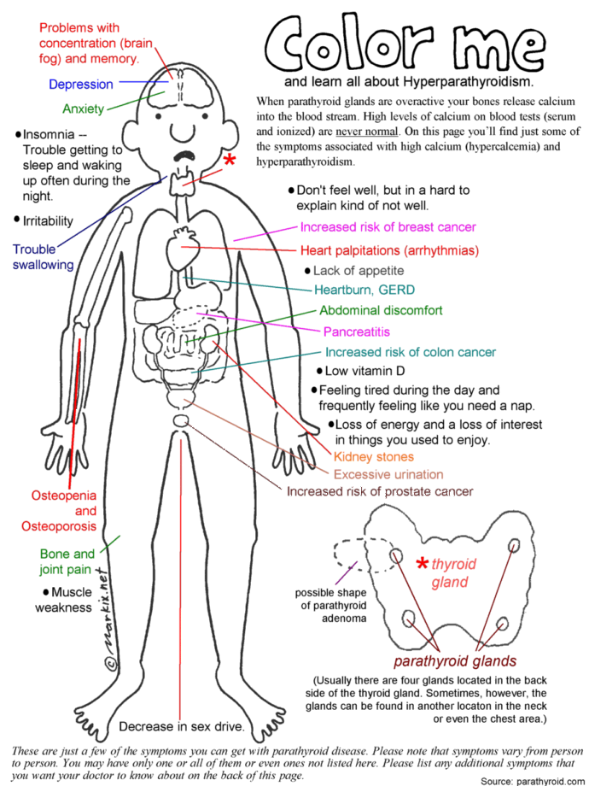

Slide 18
Differential Diagnosis
Causes of Hypercalcemia
Parathyroid - related
Vitamin D – related
Primary hyperparathyroidism
  Solitary adenomas
  Multiple endocrine neoplasia
Lithium therapy
Familial hypocalciuric hypercalcemia
Vitamin D intoxication
1,25(OH)2D; sarcoidosis and other granulomatous diseases
Idiopathic hypercalcemia of infancy

Slide 19
Differential Diagnosis
Causes of Hypercalcemia
Associated with high bone turnover
Malignancy - related
Solid tumor with metastases(breast)
Solid tumor with humoral mediation of hypercalcemia (lung kidney)
Hematologic malignancies (multiple myeloma, lymphoma, leukemia)
Hyperthyroidism
Immobilization
Thiazides
Vitamin A intoxication
Assocated with Renal Failure:
Severe secondary hyperparathyroidism
Aluminum intoxication
Milk alkali syndrome

Slide 20
Diagnosis
The presence of established hypercalcaemia in more than one serum measurement accompanied by elevated immunoreactive PTH is characteristic (iPTH)

Slide 21
Diagnosis
Serum phosphate is usually low but may be normal. Hypercalcaemia is common and blood alkaline phosphatase (of bone origin) and the urinary hydroxyproline concentrations are commonly elevated when the bones are involved. Nephrogenous CAMP is elevated in about 80% of patients but the test is rarely used because of technical difficulties

Slide 22
Other Diagnostic tests
The Glucocortisoid suppression test:
The heypercalcaemic of non-parathyroid origin e.g., vitamin D intoxication, sarcoidosis and lymphoproliferative syndromes generally respond to the administration of prednisolone in a dose of 40-60 mg daily for 10 days by a decrease in serum calcium level.

Slide 23
Other Diagnostic tests
The Glucocortisoid suppression test:
The response is unusual in hypercalcaemia secondary to primary hyperparathyroidism and ectopic PTH production.
A positive test result i.e. significant decrease in serum calcium is a contraindication to neck exploration and signals the need for investigation for a non-parathyroid cause of the hypercalcaemia.

Slide 24
Other Diagnostic tests
Radiograph:
Plain X-ray of hands can be diagnostic showing subperiosteal bone resorption usually on the radial surfacy of the distal phalanx with distal phalangeal tufting as well as cysts formation and generalzed osteopenia.

Slide 25
Other Diagnostic tests
Pre-operative localization of the abnormal parathyroid gland(s):
Ultrasonography
MRI
CT
Thallium ²⁰¹ – Tehcnichum^{99m} scan (subtraction study)

Slide 27
Treatment
A large proportion of patients have “biochemical” hyperparathyroidism but with prolonged follow up they progress to overt clinical presentation.
Resection of the parathyroid lesion is curative with recurrences observed mainly in the multiple glandular disease.

Slide 28
Medical Treatment of the hypercalcaemia
In acute severe forms the main stay of therapy is adequate hydration with saline and forced diuresis by diuretics to increase the urinary excretion of calcium rapidly along with sodium and prevent its reabsorption by the renal tubules.

Slide 29
Other agents
Glucocostiroids
  In hypercalcaemia associated the hematological malignant neoplasms
Mythramycin
  A toxic antibiotics which inhibit bone resorption and is used in hematological and solid neoplasms causing hypercalcaemia.

Slide 30
Other agents
Calcitonin
  Also inhibit osteoclast activity and prevent bone resorption
Bisphosphonates
  They are given intravenously or orally to prevent bone resorption.

Slide 31
Other agents
Phosphate
  Oral phosphate can be used as an antihypercalcaemic agent and is commonly used as a temporary measure during diagnostic workup.
Estrogen
  It also decrease bone resorption and can be given to postmenopausal women with primary hyperparathyroidism using medical therapy

Slide 32
Surgery
Surgical treatment should be considered in all cases with established diagnosis of primary hyperparthyroidism.
During surgery the surgeon identifies all four parathyroid glands (using biopsy if necessary) followed by the removal of enlarged parathyroid or 3 ½ glands in multiple glandular disease.

Slide 33
Other Complications
Deterioration of renal function
Metabolic disturbance e.g. hypomagnesia, pancreatitis, gout or pseudogout

Slide 34
Secondary hyperparathyroidism
An increase in PTH secretion which is adaptive and unrelated to intrinsic disease of the parathyroid glands is called secondary hyperparathyroidism.
This is due to chronic stimulation of the parathyroid glands by a chronic decrease in the ionic calcium level in the blood

Slide 36
Major causes of chronic hypocalcemia other than hypoparathyroidism
Dietary deficiency of vitamin D or calcium
Decreased intestinal absorption of vitamin D or calcium due to primary small bowel disease, short bowel syndrome, and post-gastrectomy syndrome.
Drugs that cause rickets or osteomalacia such as phenytoin, phenobarbital, cholestyramine, and laxative.

Slide 37
Major causes of chronic hypocalcemia other than parathyroprival hypoparathyroidism
States of tissue resistance to vitamin D
Excessive intake of inorganic phosphate compunds
Psudohypoparathyroidism
Severe hypomagnesemia
Chronic renal failure

Slide 38
Hypoparathyroidism
Deficient secretion of PTH which manifests itself biochemically by hypocalcemia, hyperphospatemia diminished or absent circulating iPTH and clinically the symptoms of neuromuscular hyperactivity.

Slide 39
Hypoparathyroidism
Causes:
Surgical hypoparathyroidism – the commonest
  After anterior neck exploration for thyroidectomy, abnormal parathyroid gland removal, excision of a neck lesion. It could be due to the removal of the parathyroid glands or due to interruption of blood supply to the glands.

Slide 40
Hypoparathyroidism
Causes:
Idiopathic hypoparathyroidism
  A form occuring at an early age (genetic origin) with autosomal recessive mode of transmission “multiple endocrine deficiency –autoimmune-candidiasis (MEDAC) syndrome”
  “Juvenile familial endocrinopathy”
  “Hypoparathyroidism – Addisson’s disease – mucocutaneous candidiasis (HAM) syndrome”

Slide 41
Hypoparathyroidism
Causes:
Idiopathic hypoparathyroidism
  Circulating antibodies for the parathyroid glands and the adrenals are frequently present.
  Other associated disease:
    Pernicious anemia
    Ovarian failure
    Autoimmune thyroiditis
    Diabetes mellitus

Slide 42
Hypoparathyroidism
Causes:
Idiopathic hypoparathyroidism
  The late onset form occurs sporadically without circulating grandular autoantibodies.
Functional hypoparathyroidism
  In patients who has chronic hypomagesaemia of various causes.
  Magnesium is necessary for the PTH release from the glands and also for the peripheral action of the PTH.

Slide 43
Hypoparathyroidism
Clinical Features:
Neuromuscular
  The rate of decrease in serum calcium is the major determinant for the development of neuromuscular complications.
  When nerves are exposed to low levels of calcium they show abnormal neuronal function which may include decrease threshold of excitation, repetitive response to a single stimulus and rarely continuous activity.

Slide 44
Hypoparathyroidism
Clinical Features:
Neuromuscular
  Parathesia
  Tetany
  Hyperventilation
  Adrenergic symptoms
  Convulsion (More common in young people and it can take the form of either generalized tetany followed by prolonged tonic spasms or the typical epileptiform seizures.
  Signs of latent tetany
    Chvostek sign
    Trousseau sign
    Extrapyramidal signs (due to basal ganglia calcification)

Slide 45
Hypoparathyroidism
Clinical Features:
Other clinical manifestation
  Posterio lenticular cataract
  Cardiac manifestation:
  Prolonged QT interval in the ECG
  Resistance to digitalis
  Hypotension
  Refractory heart failure with cardiomegally can occur.

Slide 46
Hypoparathyroidism
Clinical Features:
Other clinical manifestation
  Dental Manifestation
  Abnormal enamel formation with delayed or absent dental eruption and defective dental root formation.
  Malabsorption syndrome
  Presumably secondary to decreased calcium level and may lead to steatorrhoea with long standing untreated disease.

Slide 47
Hypoparathyroidism
Diagnosis:
In the absence of renal failure the presence of hypocalcaemia with hyperphosphataemia is virtually diagnostic of hypoparathyroidism. Undetectable serum iPTH confirms the diagnosis or it can be detectable if the assay is very sensitive.

Slide 48
Hypoparathyroidism
Treatment:
The mainstay of treatment is a combination of oral calcium with pharmacological doses of vitamin D or its potent analogues.
Phosphate restriction in diet may also be useful with or without aluminum hydroxide gel to lower serum phosphate level.

Slide 49
Emergency Treatment for Hypocalcaemic
Tetany:
Calcium should be given parenterally till adequate serum calcium level is obtained and then vitamin D supplementation with oral calcium should be initiated.

Slide 50
Emergency Treatment for Hypocalcaemic
Hungry bone syndrome:
In patients with hyperparathyroidism and severe bone disease who undergo successful parathyroidectomy hypocalcaemia may be severe and parenteral calcium infusion with later supplementation with oral calcium and vitamin D.

Slide 51
Pseudohypoparathysoidism and Pseudopseudohypoparathyroidism
A rare familial disorders with target tissue resistance to PTH.
There is hypocalcaemia, hyperphosphataemia, with increased parathyroid gland function.
There is also a variety of congenital defects in the growth and development of skeleton including:
    Short statue
    Short metacarpal and metatarsal bones

Slide 52
Pseudohypoparathysoidism and Pseudopseudohypoparathyroidism
In pseudopseudohypoparathyroidism they have the developmental defects without the biochemical abnormalities
The diagnosis is established when low serum calcium level with hyperphosphataemia is associated with increased serum iPTH as well as diminished nephrogenous CAMP and phosphature response to PTH administration

Slide 53


